Slide 1



METIS
Building tomorrow on proven foundations.

Slide 2
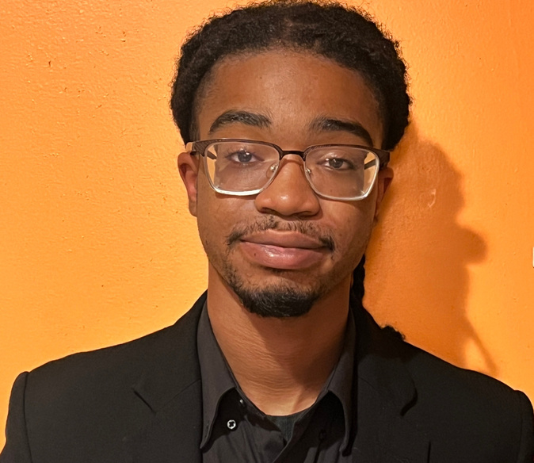
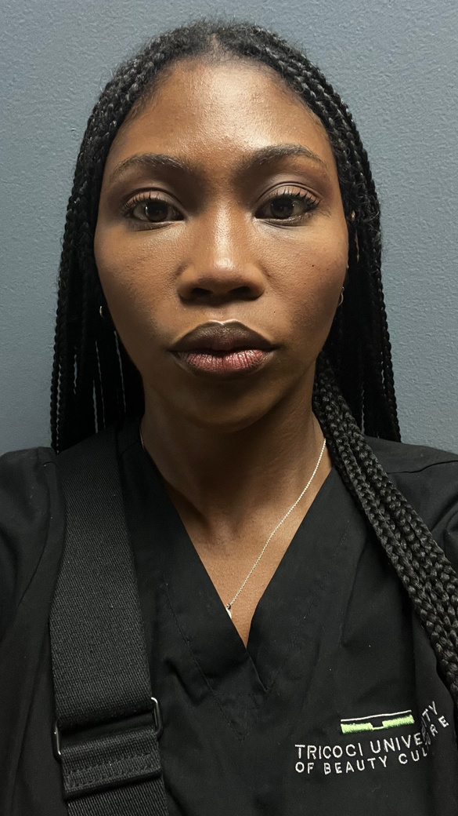
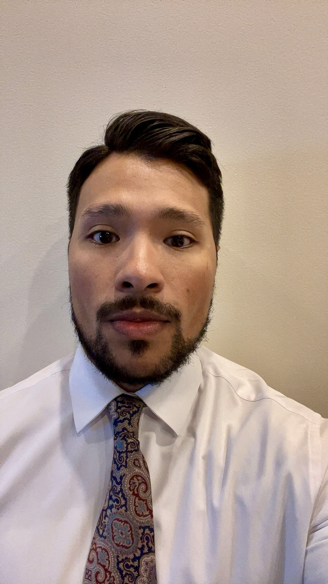
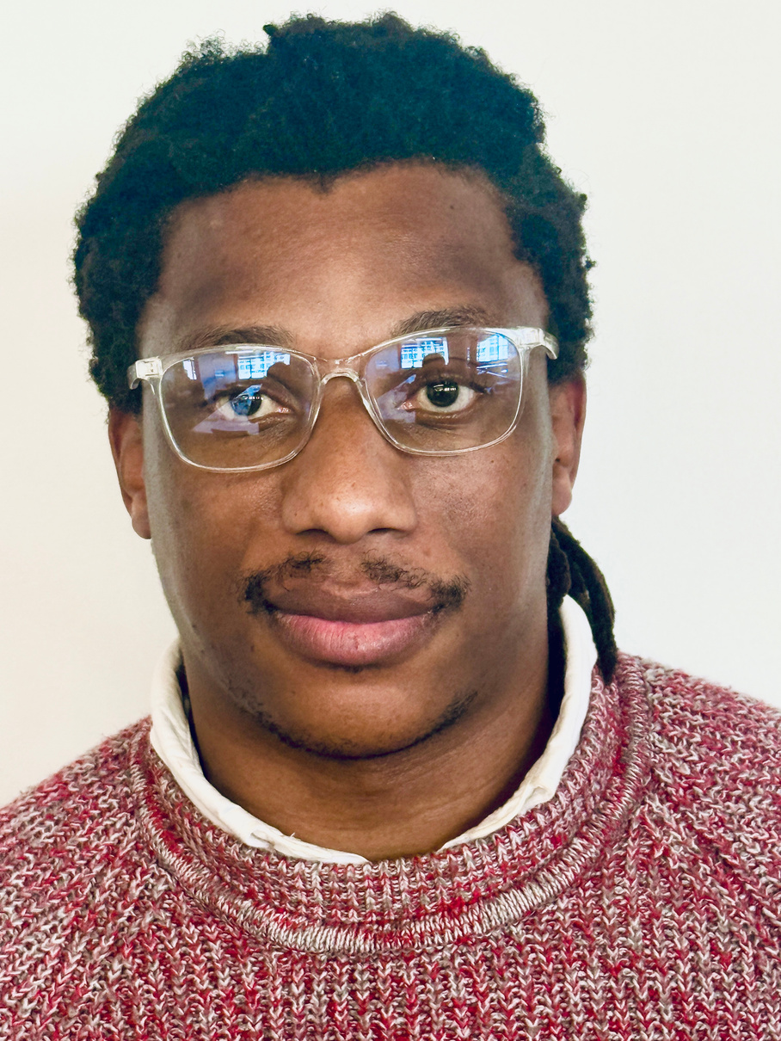

Meet the Team
Khayyel Johnson
UX Developer
Maati Young
Program Manager
Charlie Mejia
Business Analyst
Bonny Makaniankhondo
Software Dev

Slide 3
Our Mission
We bridge the gap between legacy systems and modern capabilities, helping established companies move at startup speed without startup risk.
Notes:
*Say the mission

Slide 4
Our Vision
Partnering with established enterprises to unlock their full potential through intelligent technology.
Notes:
*Charlie's part

Slide 5
Data Model
Our data model links every piece of customer feedback to a unified customer profile, tracks issues through resolution, and stores AI-generated sentiment scores, enabling the excutives to see complete context and take immediate action.

Slide 6



TECH STACK
React
PowerBI
for fast filtering and one-click actions
embedded for actionable insights.
Azure SQL
Azure Cognitive Services
for centralized feedback storage
for automatic sentiment analysis

Slide 7
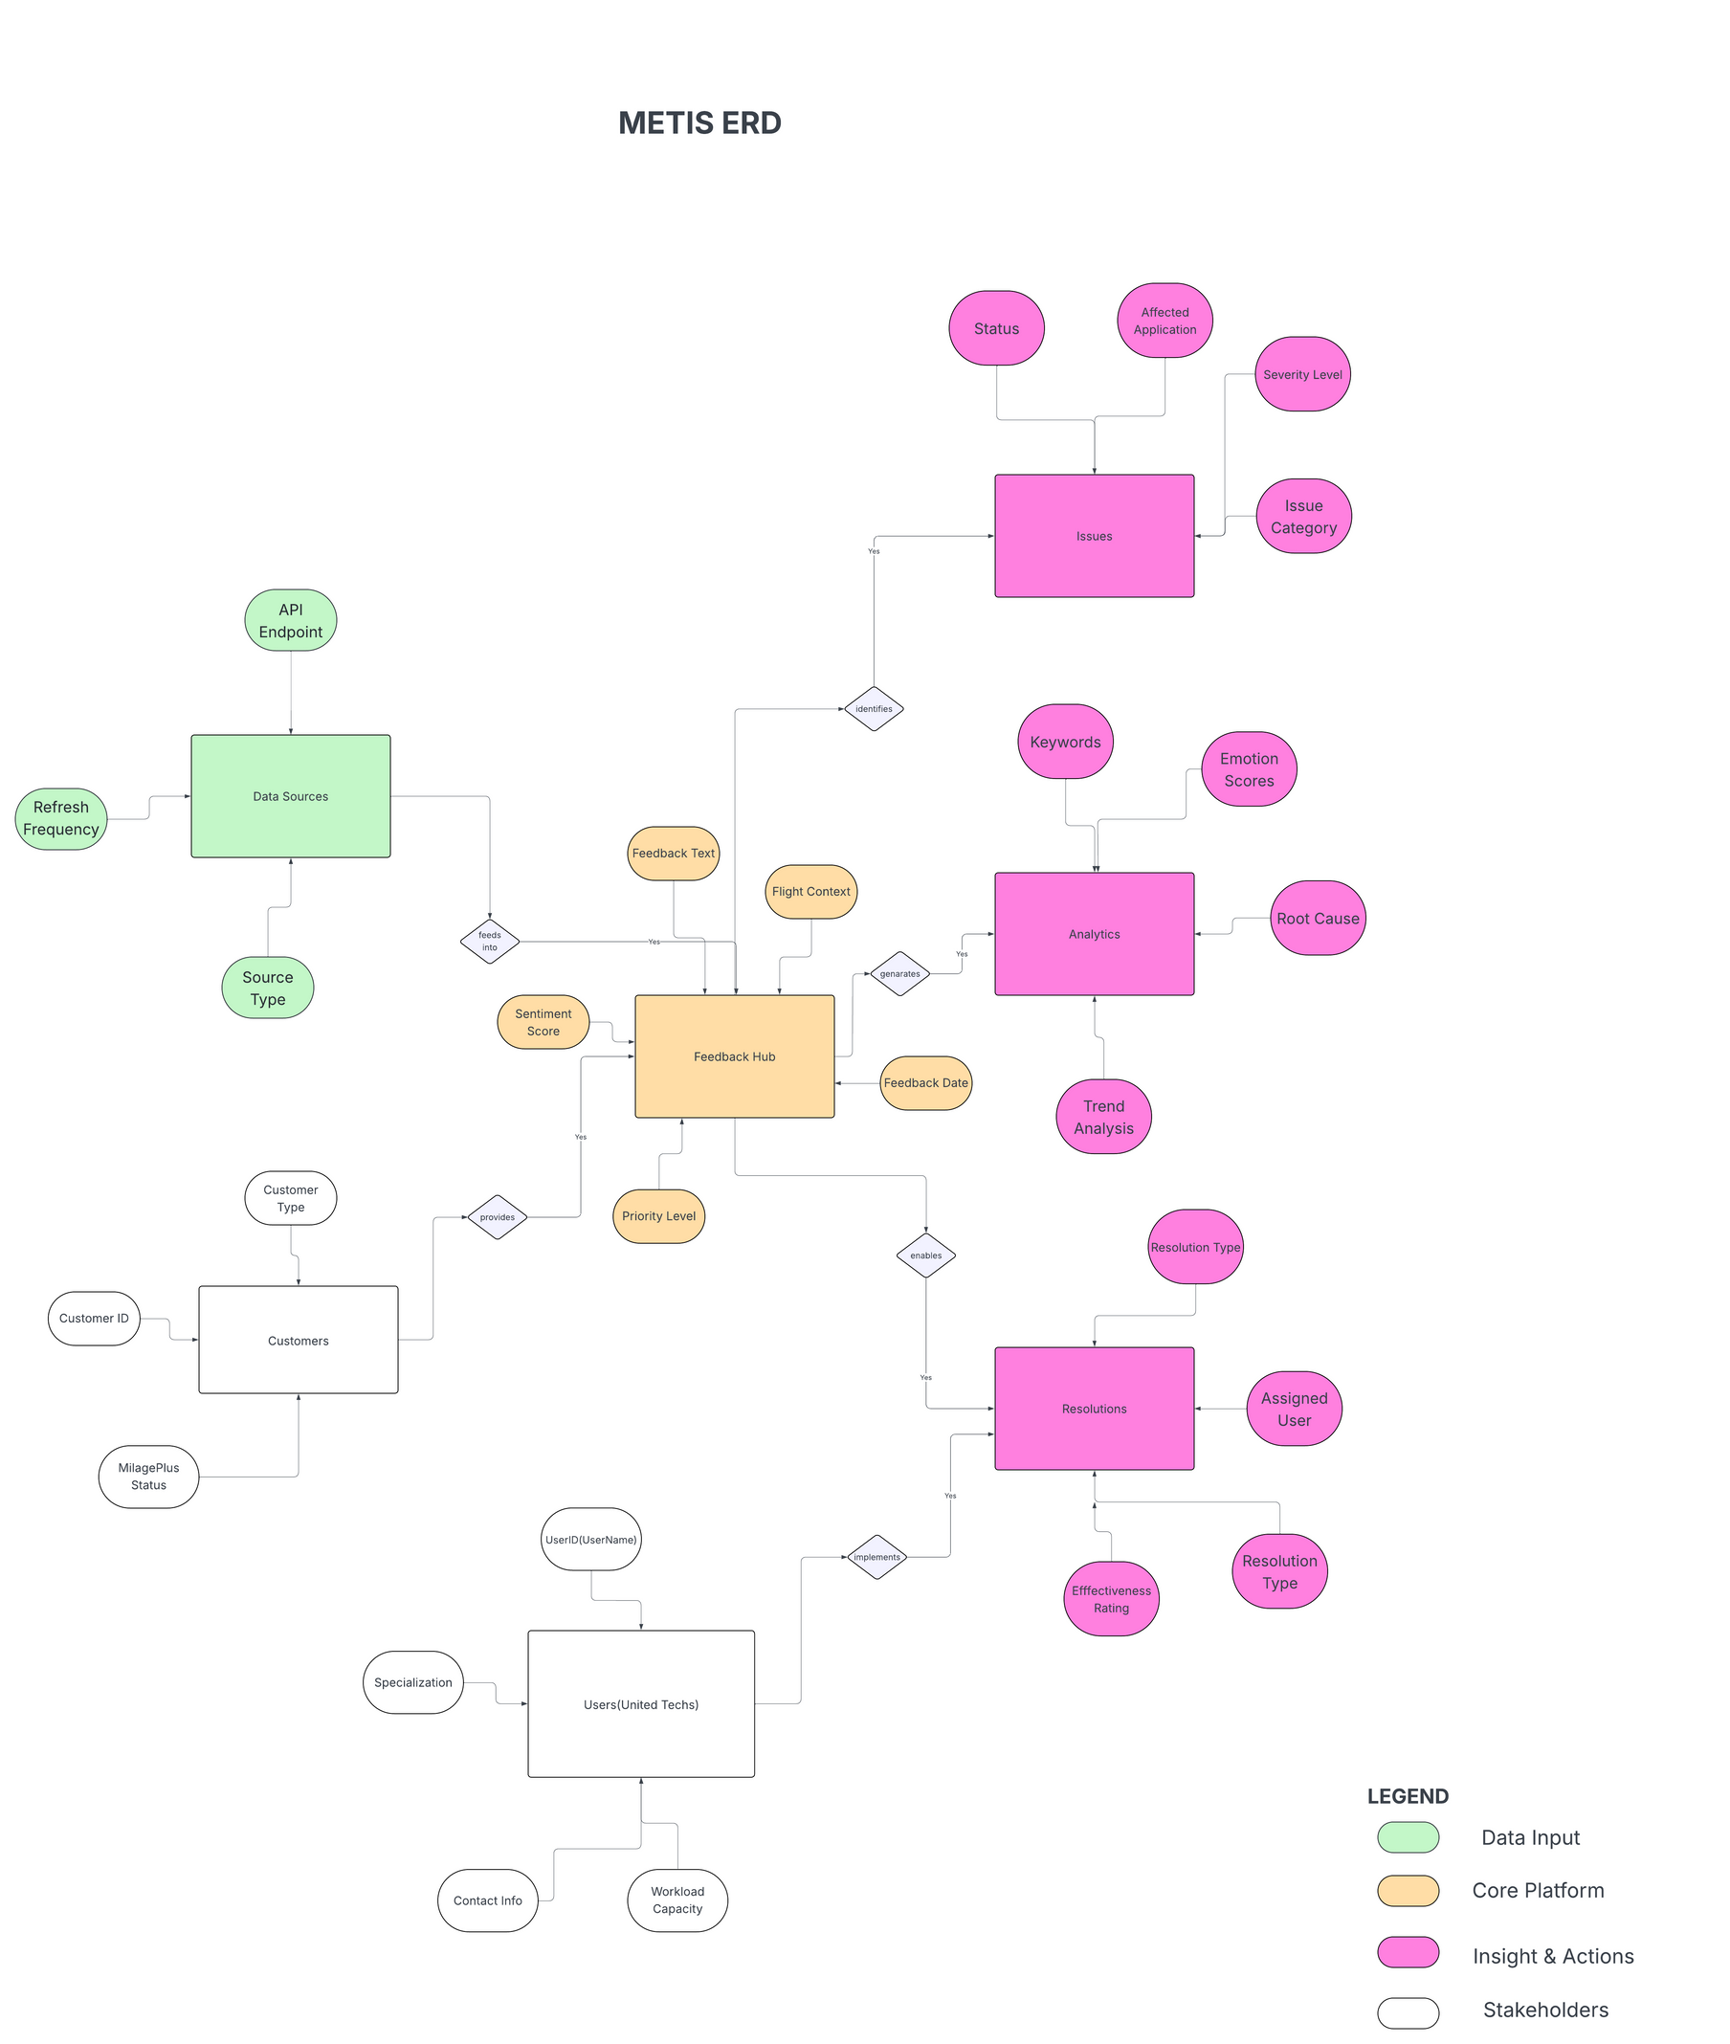

Slide 8


Education
MBA from Northwestern Kellog
Motivation
Income
Drive strategic decisions that improve United’s customer satisfaction scores and competive postioning. Needs high-level insights to allocate resources effectively accross departments and justify budgets investments to the board
180,000 + annually
Personality
Extrovert, Analytical
Sarah Chen
Marital Status
Married with two children
Email Preference
Short to the point- bullet points & executive summaries only
Age : 38
VP of Customer Experience
Chicago, IL (United HQ)

Slide 9
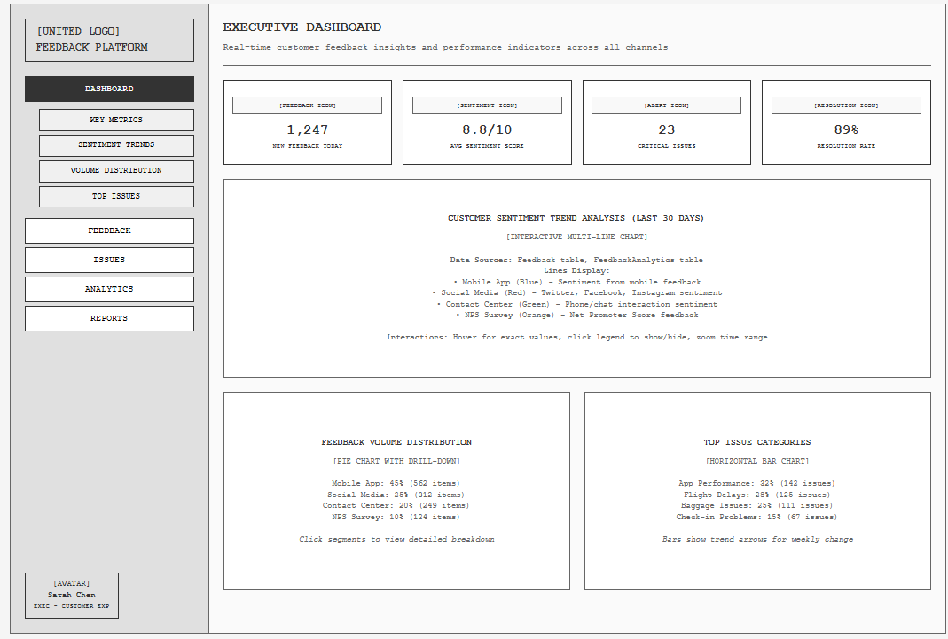

Slide 11

Education
Motivation
Bachelor’s in Business Administration
Efficiently process high volumes of customer feedback and ensure critical issues get immediate attention. Needs to prioritize issues by severity, escalate problems to appropriate teams quickly, and track resolution progress. Success measured by response time, customer satisfaction improvement, and issue resolution rate.
Income
65,000+ annually
Personality
Introvert, Analytical
Jennifer Thompson
Marital Status
Married with one child
Email Preference
Long and detailed - wants context, background information, and comprehensive action plans
Age : 34
Customer Service Team Supervisor
Chicago, IL (United HQ)

Slide 12
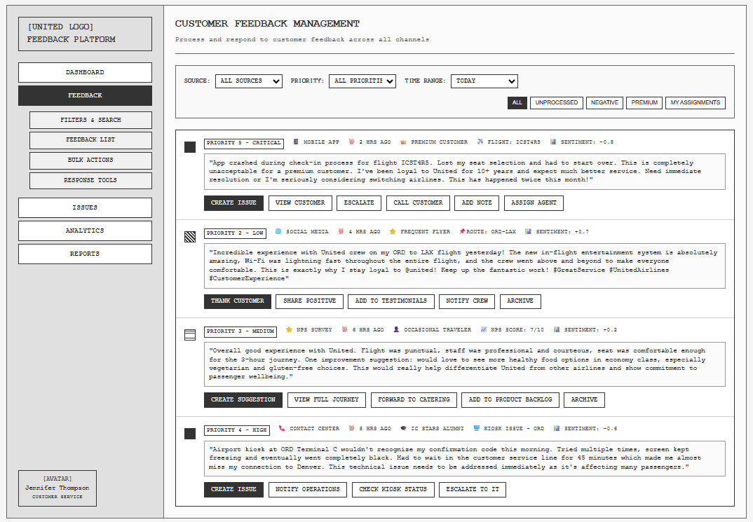

Slide 13
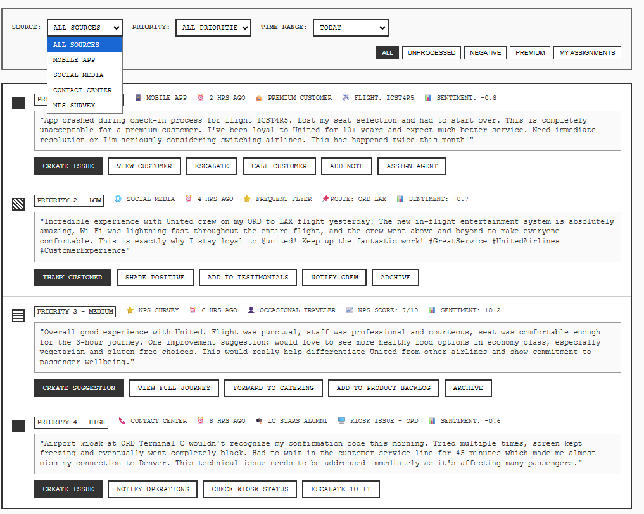

Slide 14
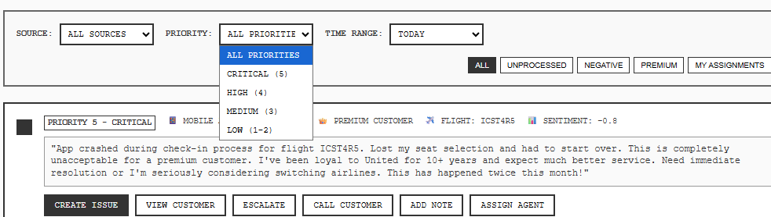

Slide 15


Education
Bachelor's in Operations Management
Motivation
Maintain smooth airport operations and minimize customer disruptions. Success measured by on-time performance, customer wait times, and incident resolution speed. Needs immediate alerts to deploy teams effectively during operational challenges.
Income
85,000 annually
Personality
Extrovert, Creative (problem-solving focused)
Marcus Rodriguez
Marital Status
Single
Email Preference
Short to the point - immediate action items and clear next steps
Age : 47
Airport Operations Manager
Chicago, IL

Slide 16
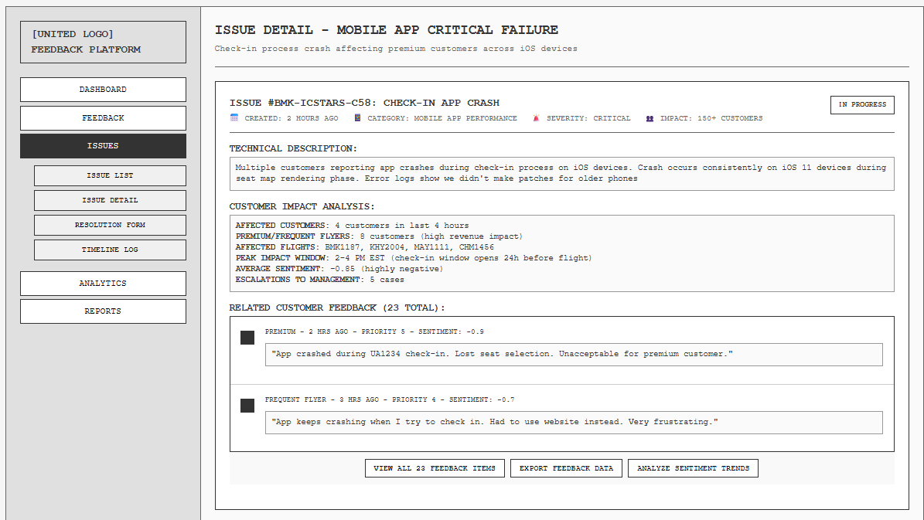

Slide 17
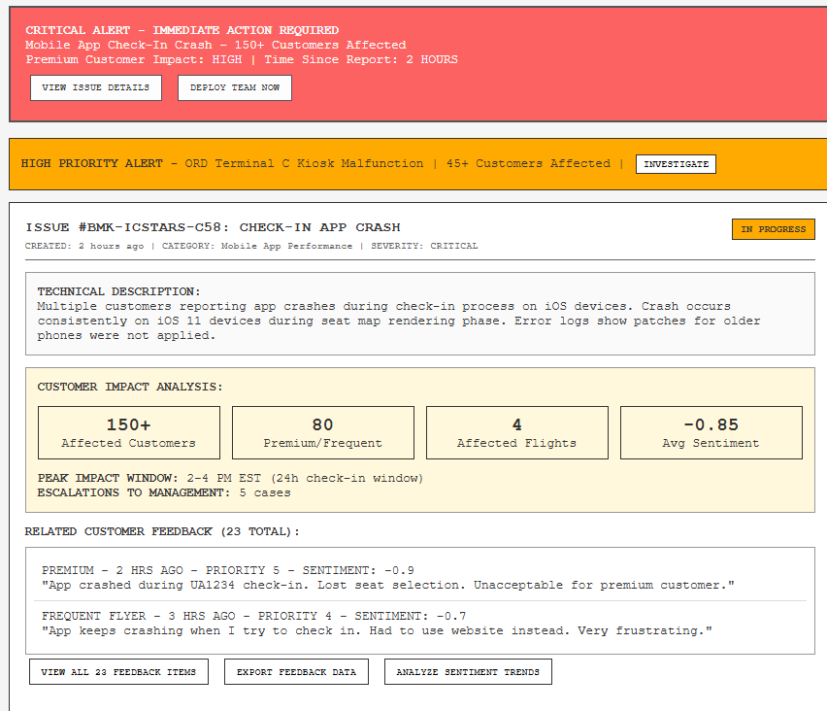

Slide 18
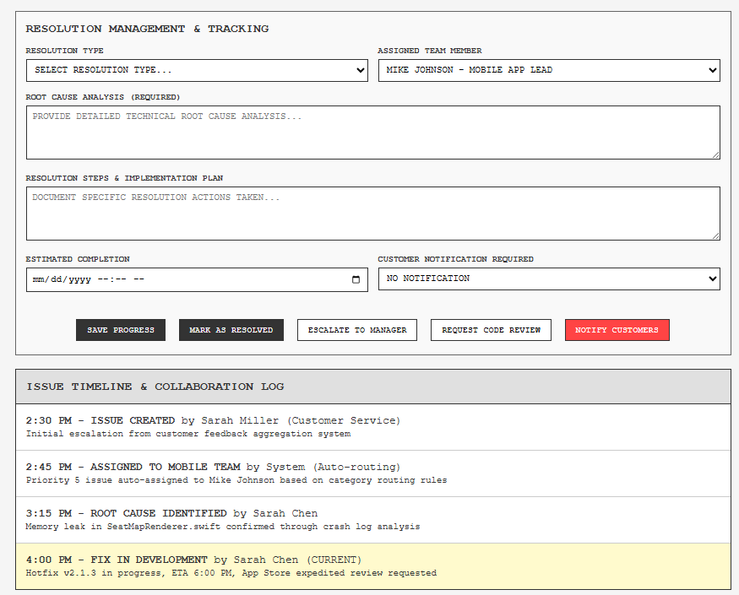

Slide 19


Education
Master's in Data Science
Motivation
Income
Uncover hidden patterns in customer behavior and feedback that drive business improvements. Passionate about using advanced analytics to predict customer needs and identify process inefficiencies. Success measured by accuracy of predictive models and actionable insights delivered to leadership.
80,000 annually
Personality
Introvert, Analytical
David Park
Marital Status
Single
Email Preference
Long and detailed - technical specifications, methodology explanations, and comprehensive data insights
Age : 55
Customer Analytics Specialist
Chicago, IL
Notes:
Meet David Park, Senior Customer Analytics Specialist. David analyzes customer data to predict trends and recommend improvements by using advanced analytics.
David's Challenge:
"David has a challenge and he needs detailed feedback data with AI insights so he can identity trends and recommend process improvements
When there's a challenge there's a solution....
*Don't say words in parenthesis. Only if more details are requested.

Slide 20
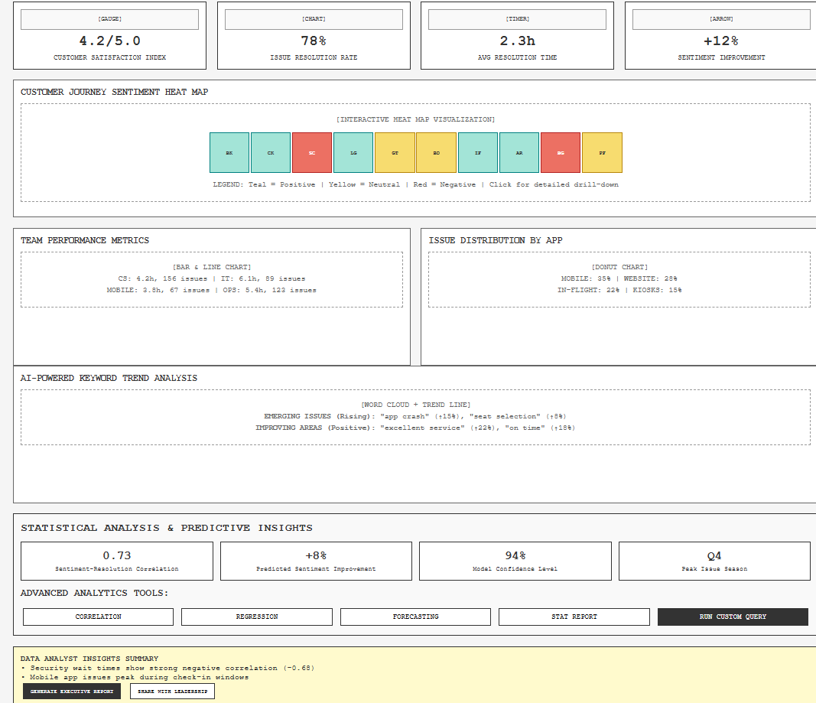
Notes:
Right now you are looking at Dash. United's 1. Pinpoint Critical gaps in Customer Journey
*Don't say words in parenthesis. Only if more details are requested.

Slide 21
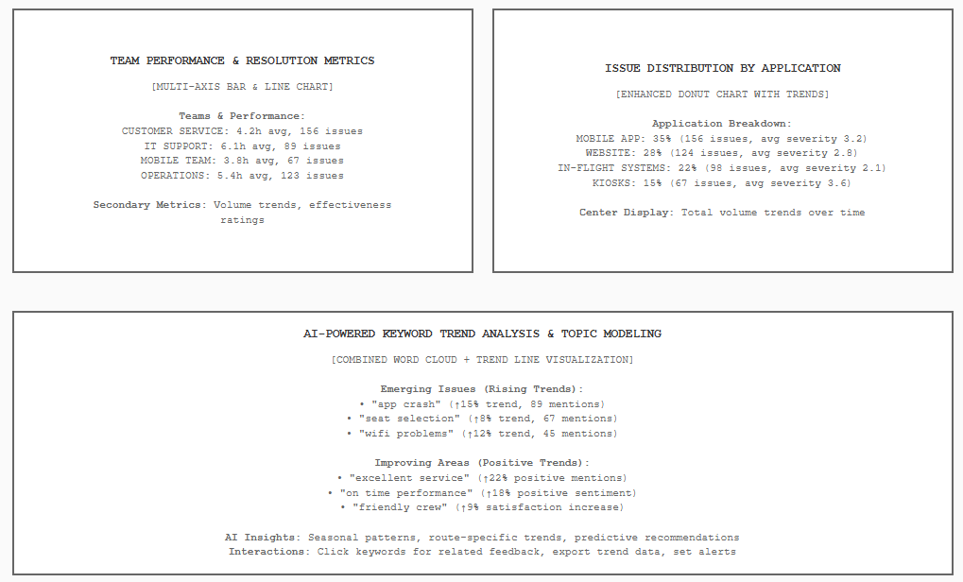
Notes:
3. Matching Support Resources to Workload and Performance (Point to Issue distribution section on presentation)
In conclusion as a team, the users will contribute to faster issue resolution (from identification to customer communication), higher customer satisfaction scores (especially for disrupted journeys), better operational efficiency (fewer manual processes more automated responses), reduced customer destination impact (fewer missed connections, shorter delays), and increased proactive communication (customers informed before problems affect them).
(As a Senior Customer Analytics Specialist, I need to cross-reference positive customer feedback trends in the AI-Powered Keyword Trend Analysis (e.g., "excellent service," "on time") with the operations team's performance metrics (Ops: 5.4h, 123 issues), so that I can validate which operational improvements are successfully driving positive customer sentiment and advocate for scaling those initiatives across the organization.)
*Don't say words in parenthesis. Only if more details are requested.

Slide 22
Real quotes from users -
Marcus Rodriguez - “Best platform I have ever used”
Jennifer Thompson - “I wish Metis created this gem sooner!”
David Park - “Better than Delta’s Program”
Sarah Chen - “Dashboard of the year if you ask me 10/10"
Notes:
not needed. only real reviews, no fluff

Slide 23
Delivery Date
TIMELINE

Slide 24
THANK YOU
METIS
Building tomorrow on proven foundations.

